Slide 1

Infrastructure as remote code execution

Slide 2

Introduction
Michael McCabe
President of Cloud Security Partners
Help clients with cloud strategy and security
Passionate about infrastructure as code

Slide 3

What are we talking about
Terraform
Infrastructure as code
Codified and consistent
“With Terraform, you can create, modify, and destroy your infrastructure in a consistent and repeatable way.”
Notes:
Terraform free and open source
IAC
Infrastructure as code – define your infra in code
Centralize and control deployments
Consistent deployments

Slide 4

Benefits
Centralize deployments
Deploy consistent infrastructure
Codified infrastructure
Can apply security controls for preventative measures

Slide 5

Challenges
Terraform is often given high privileged roles
Multiple ways to use Terraform to execute code
Terraform is a great way to gather data about an environment
Various ways to bypass security controls

Slide 6

experience
Helped move large financial organizations to self service model
Thousands of rules
Dozens of services
Thousands of users
Zero security findings from deployed infrastructure
Powerful preventative control
Maps to internal and external controls

Slide 7
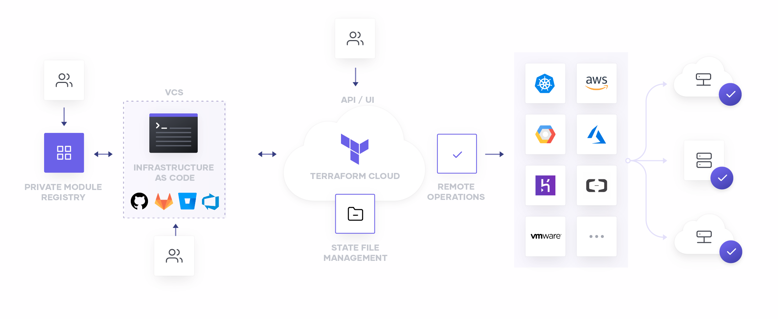

Slide 8

How does it work
Terraform plan – plans what will be created, updated, or destroyed
Calculates the current state and end state
Creates dependency tree
Outputs plan for what will be created, updated, destroyed
Determines unknown values…
Terraform apply – creates the infrastructure
Makes changes based on plan
Updates state to track the current environment
Outputs changes

Slide 9
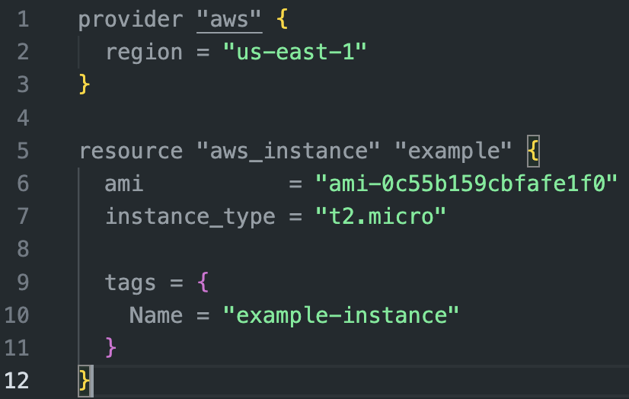

Slide 10
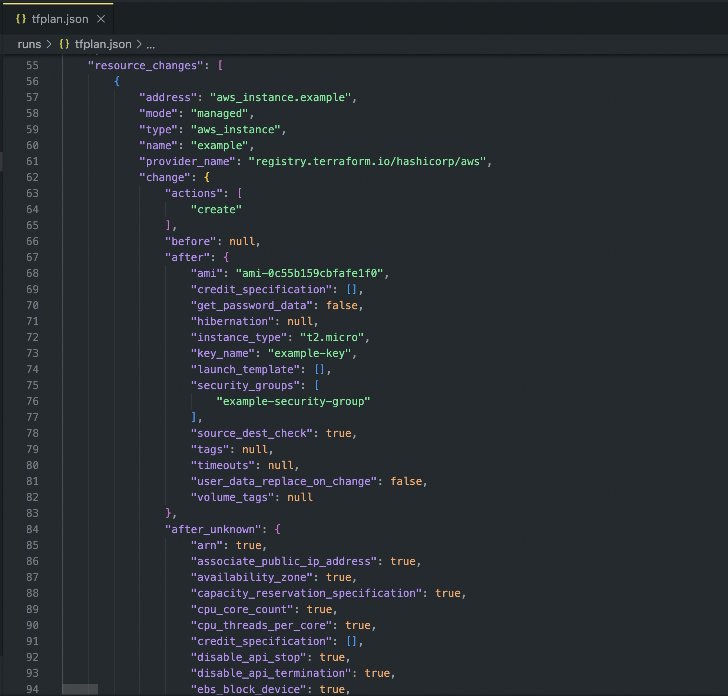

Slide 11
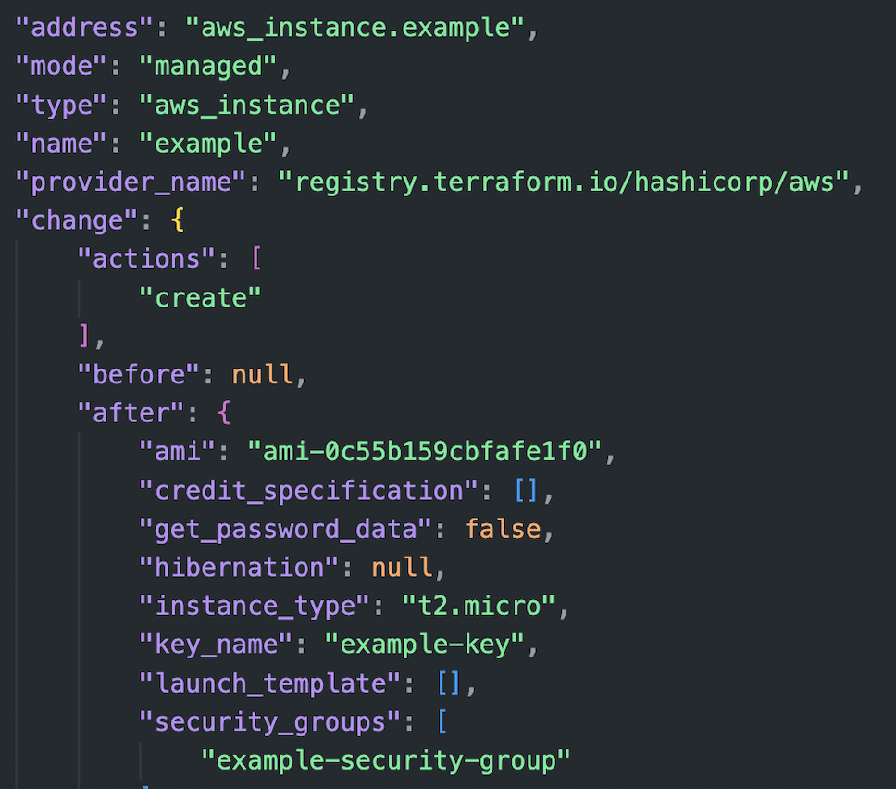

Slide 12

Terraform state
Stores current state of environment
Used to managed updates, deletes
Drift detection
Holds secrets..
Notes:
Sysdig reported an attacker using terraform state to grab secrets
https://sysdig.com/blog/cloud-breach-terraform-data-theft/

Slide 13
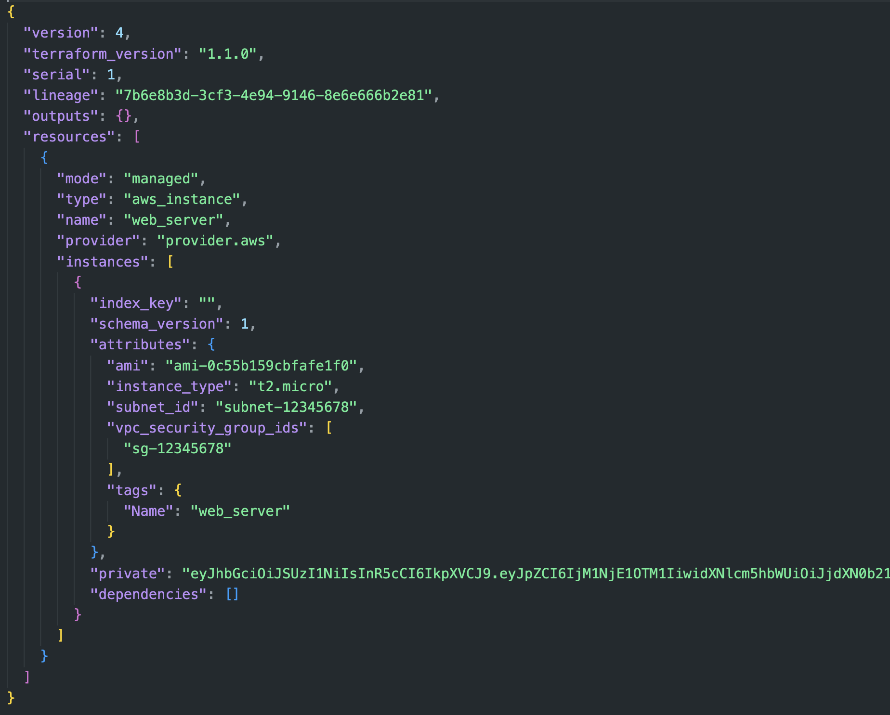

Slide 14
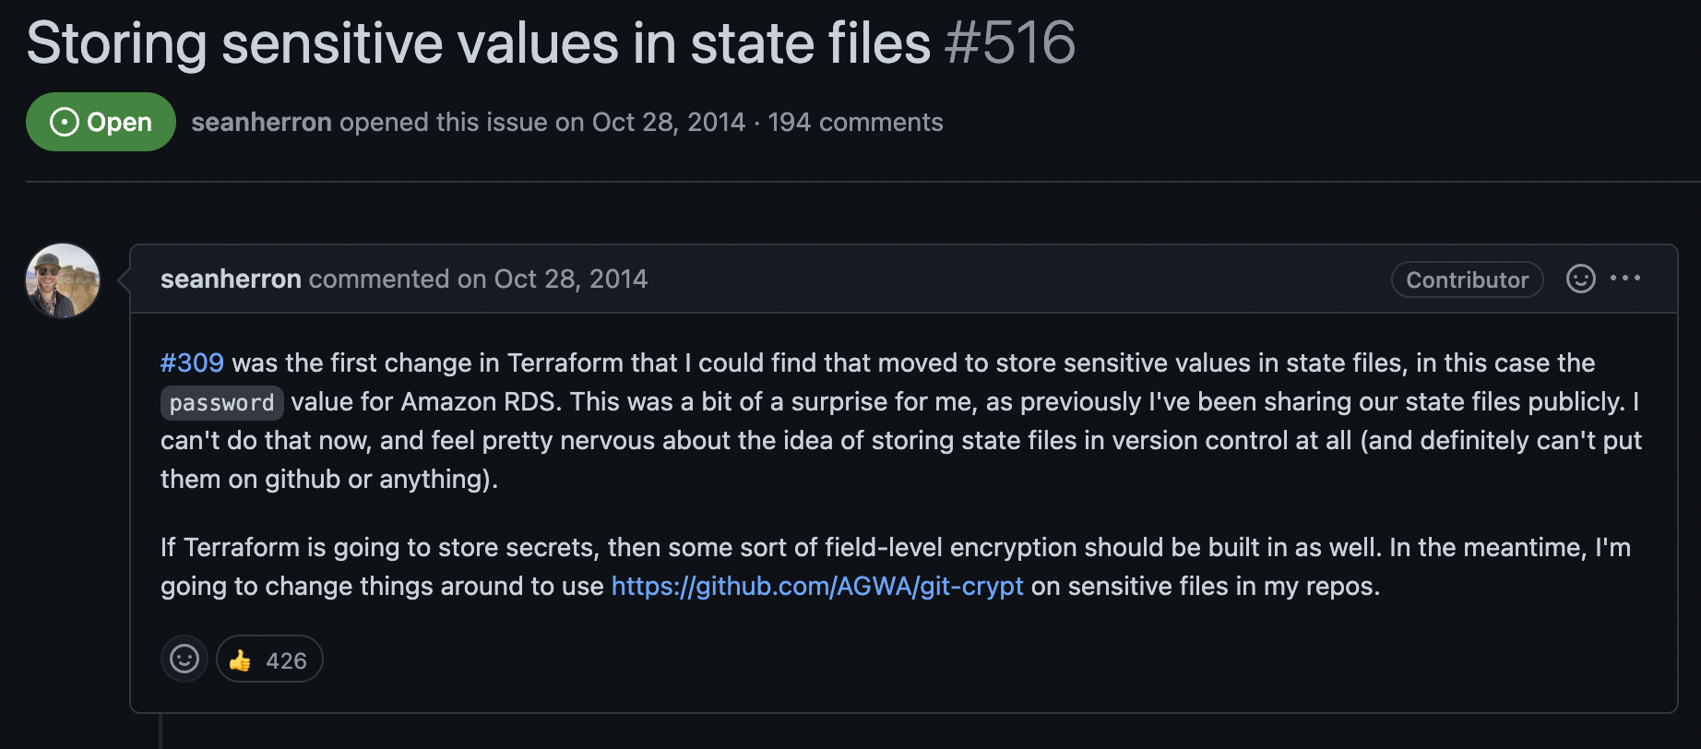


Slide 15
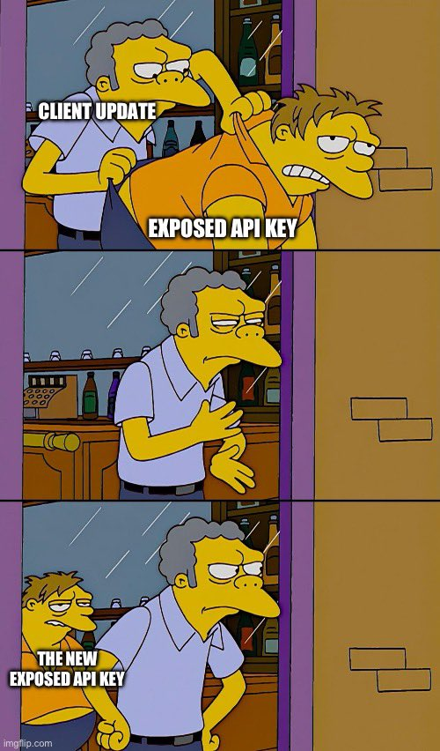

Slide 16
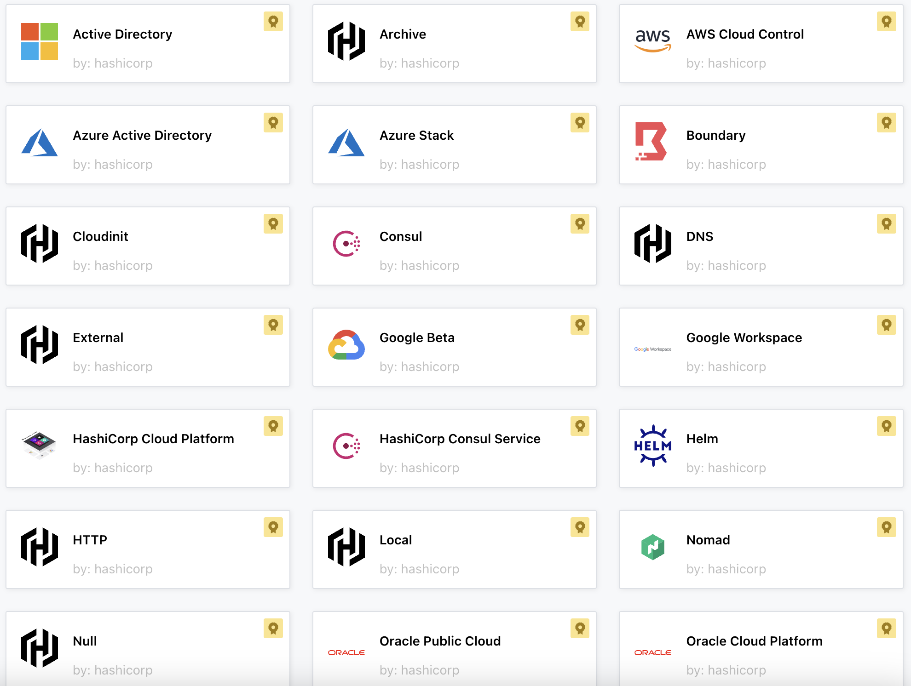

Slide 17

TERRAFORM APIs
Dozens of APIs
Privileged APIs
Update state
Update variables
Various levels of access
Notes:
Terraform cloud has dozens of APIs to control as well
Another attack surface
Various privilege levels to normalize and figure

Slide 18
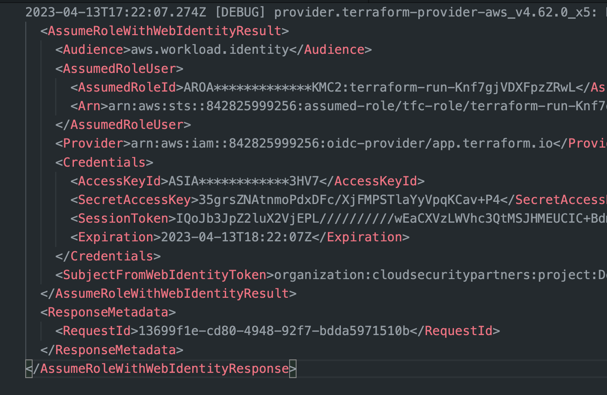
TERRAFORM Logging
Verbose logging
Secrets
Sessions
TF_LOG
Notes:
Terraform cloud has dozens of APIs to control as well
Another attack surface
Various privilege levels to normalize and figure

Slide 19


Slide 20

techniques
Provisioners
remote-exec
local-exec
file
dns
Data
external-data
http

Slide 21
Remote-exec
Used to run scripts on remote hosts after provisioning
Anti-pattern
Introduces code to infrastructure deployments
“they also add a considerable amount of complexity and uncertainty to Terraform usage”
Notes:
https://developer.hashicorp.com/terraform/language/resources/provisioners/syntax

Slide 22
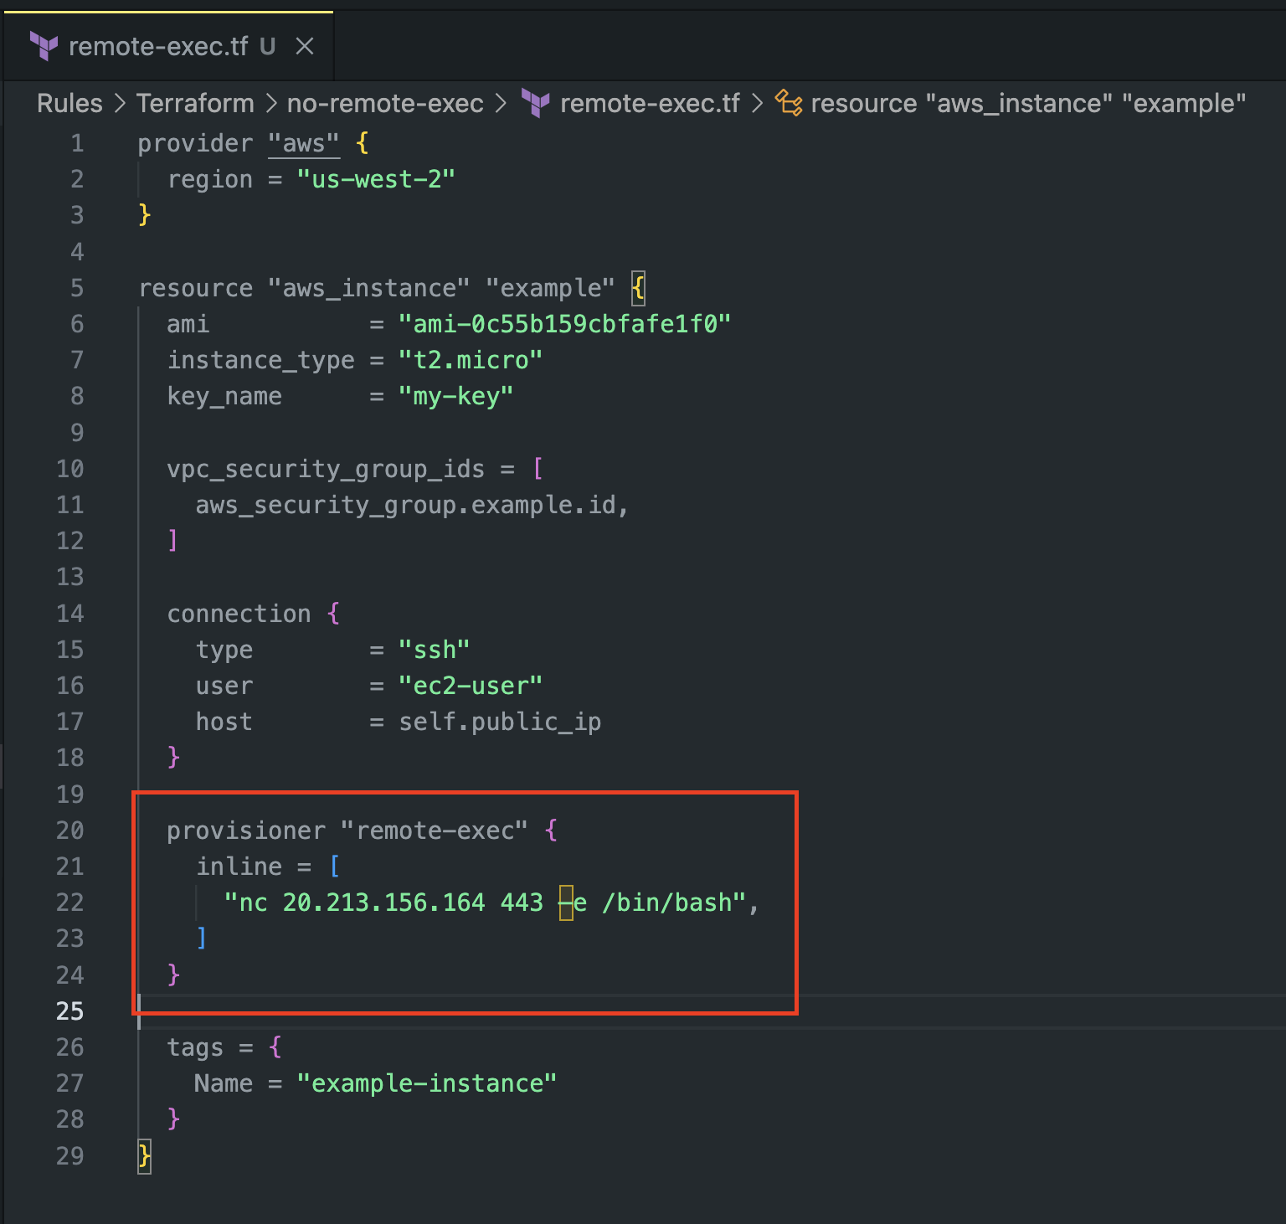
Remote exec
Setup an EC2
Determine connection
Create reverse shell to external IP

Slide 23
LOCAL-ExEC
Invokes a process on the machine running Terraform
Anti-pattern
Introduces code to infrastructure deployments
Utilizes highly privileged Terraform role
“Important: Use provisioners as a last resort. There are better alternatives for most situations.”
Notes:
https://developer.hashicorp.com/terraform/language/resources/provisioners/syntax

Slide 24
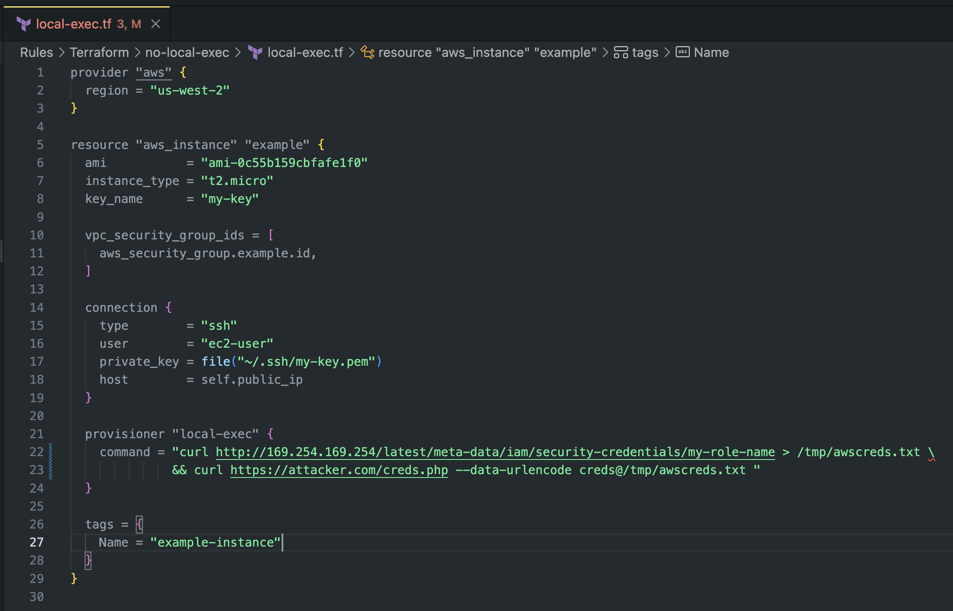
LOCAL-EXEC
Completes infrastructure build
Runs curl command against metadata endpoint
Curls output to remote webserver

Slide 25


semgrep
Basic pattern matching
Integrate with pipelines
Fast
Opensource rulesets

Slide 26
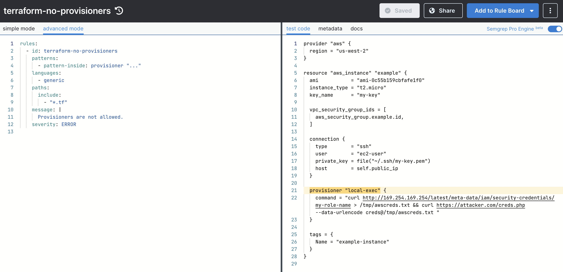
Solutions?

Slide 27
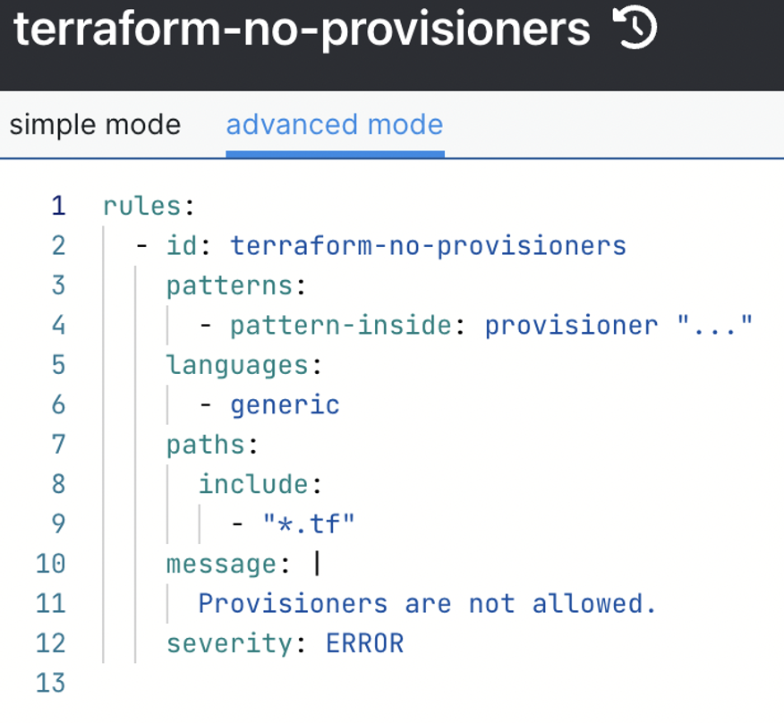
Solutions?

Slide 28

Data gathering methods
HTTP Provider
External data
Many more

Slide 29
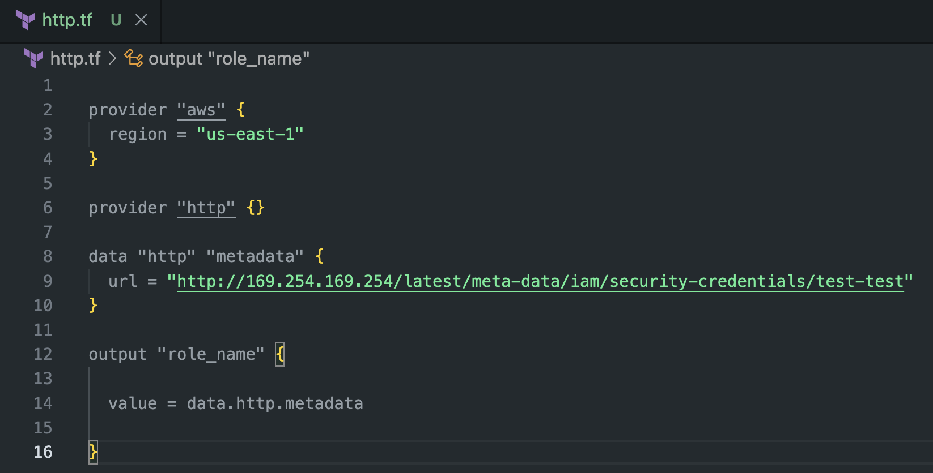
HTTP Provider

Slide 30
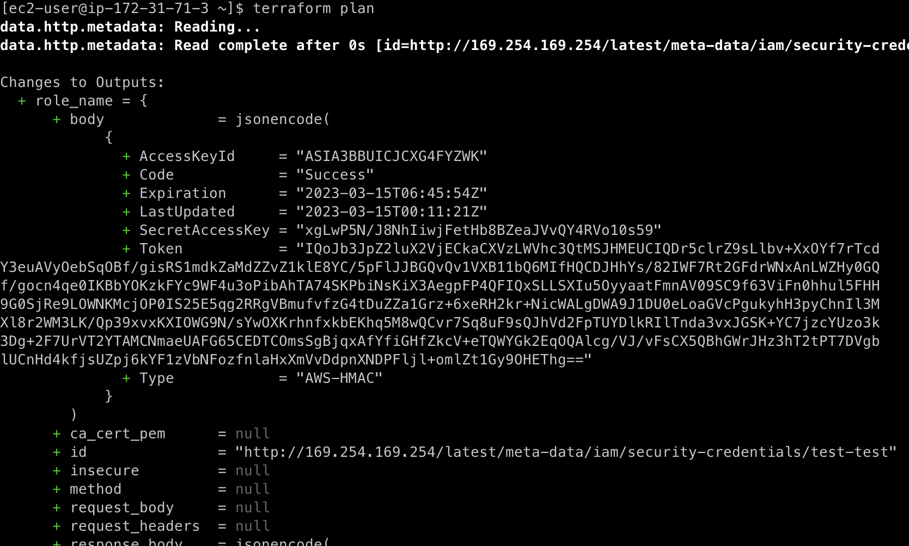

Slide 31
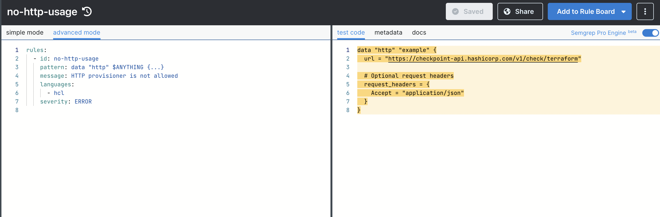
Solutions?

Slide 32
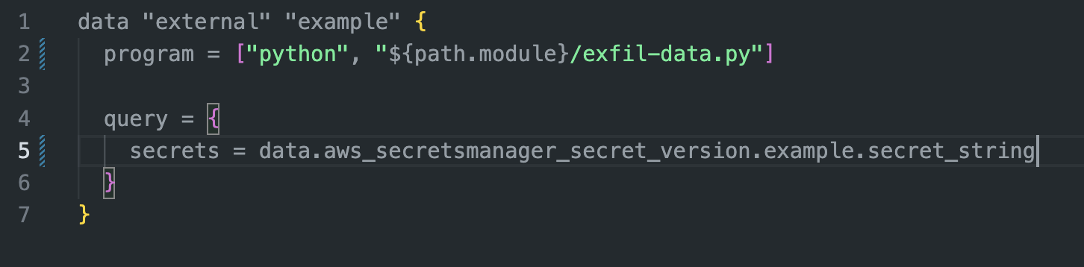

Slide 33

We want more
More in-depth testing
Resource specific checks
Decision making logic

Slide 34
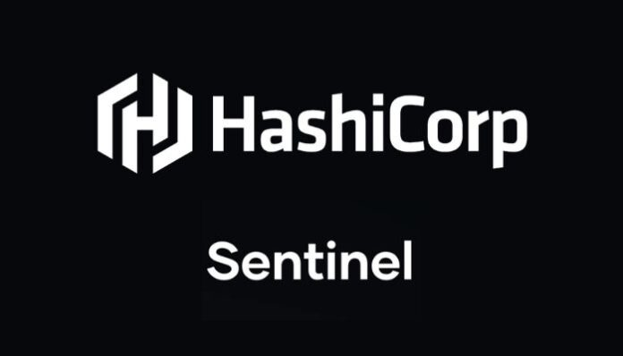

SOLUTIONS
OPA Rego
Hashicorp Sentinel

Slide 35
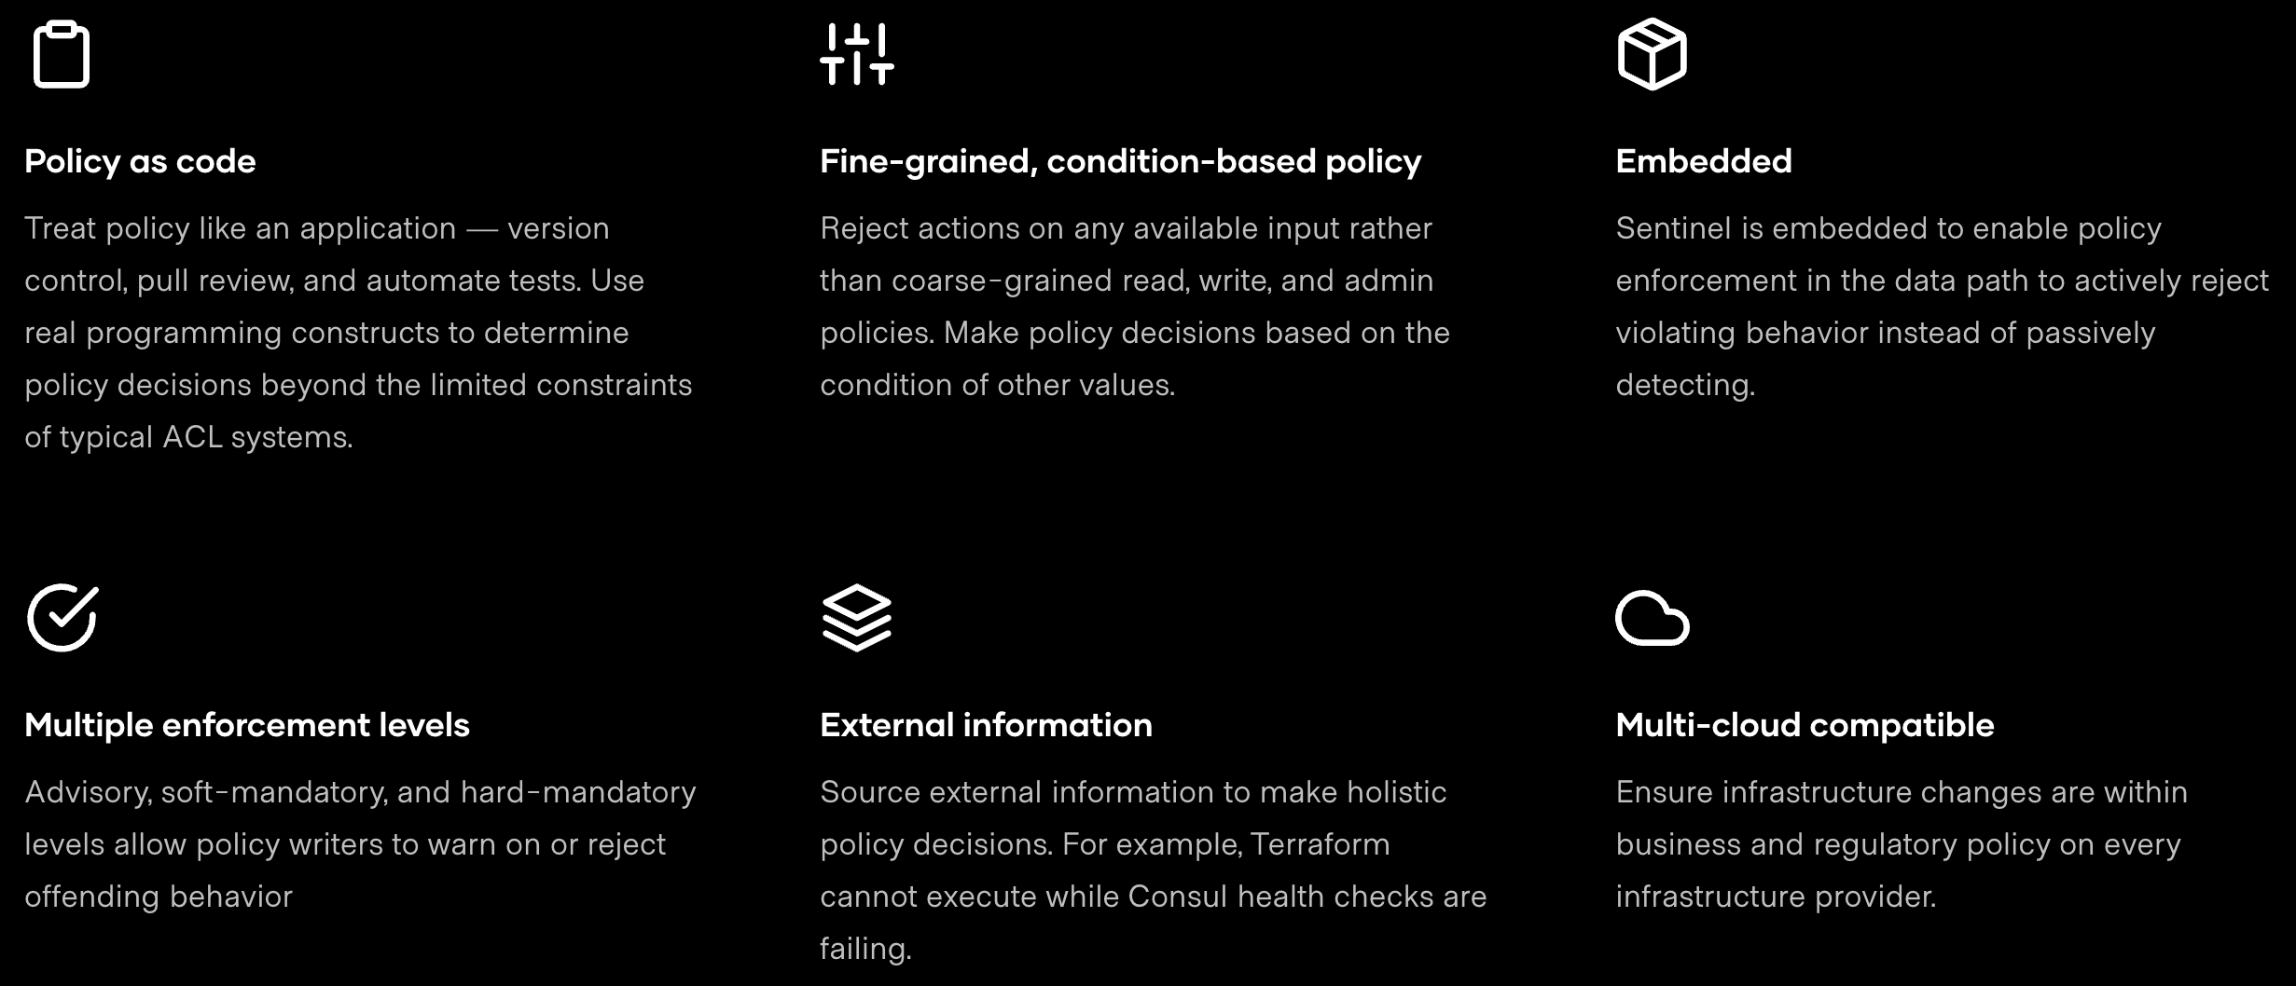

Slide 36
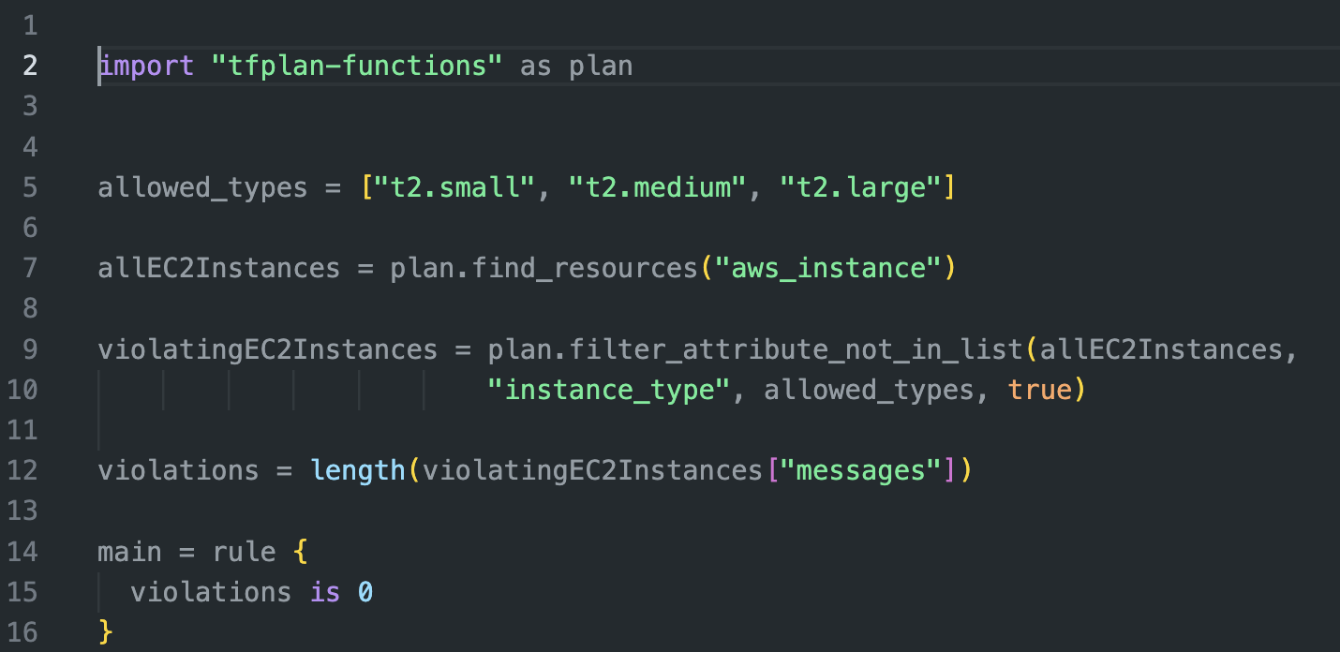

Slide 37
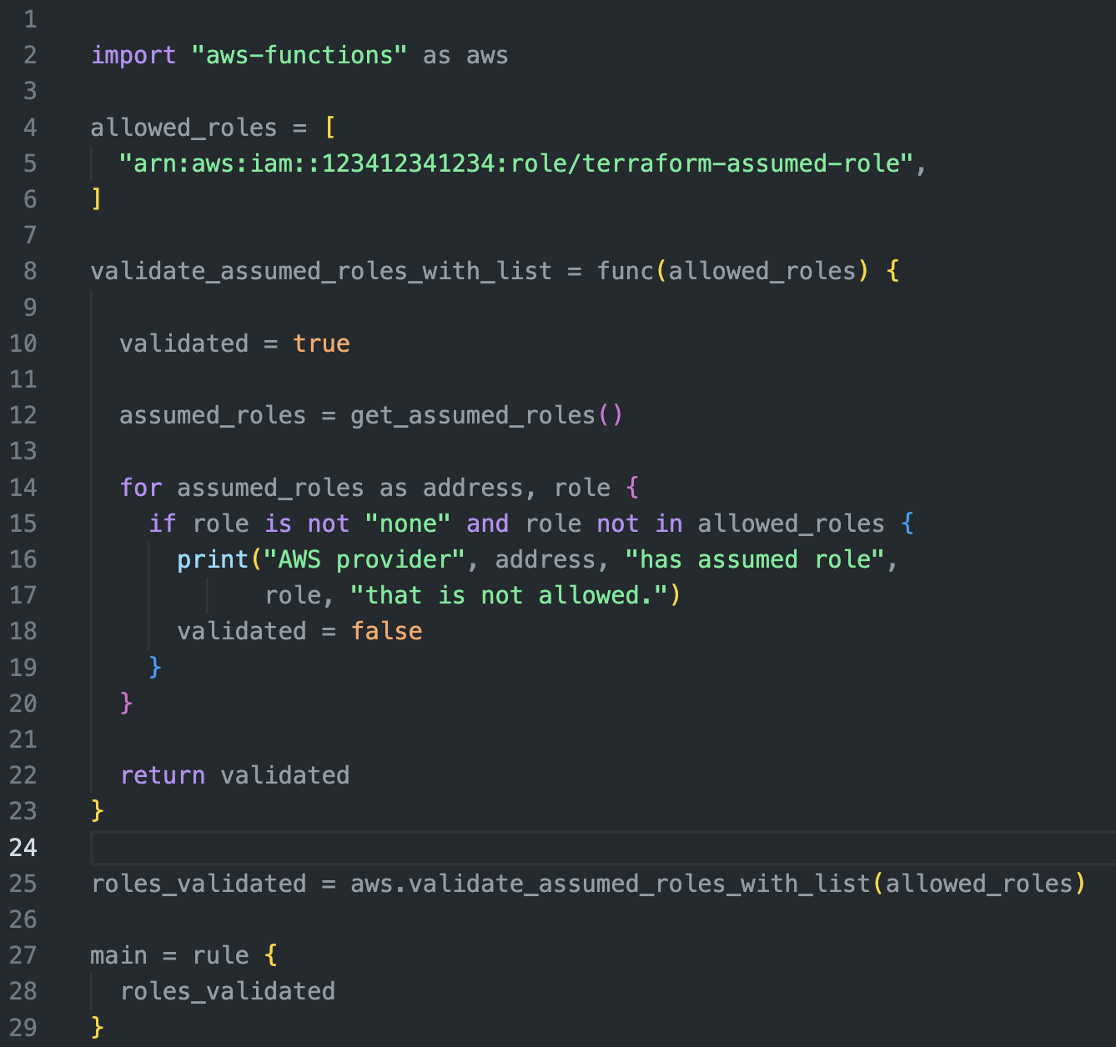

Slide 38
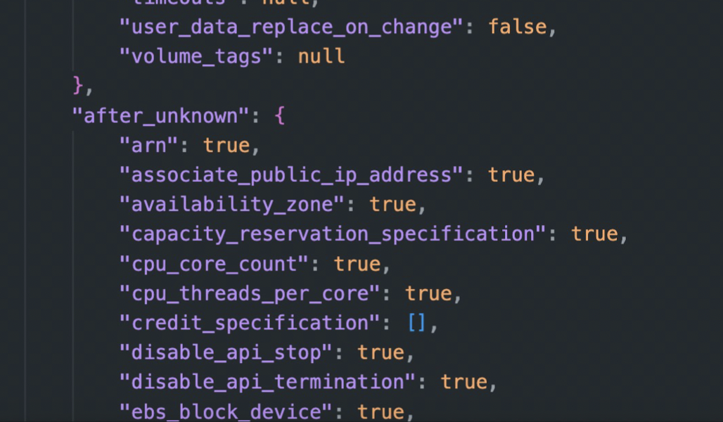
After Unknowns
Values aren’t in plan
Values are created
Easy to manipulate
Bypasses plan time checks
Must have explicit checks

Slide 39

Solutions - Layer your defenses
IAM
Build patterns for use cases
Service guard rails
IAM
Code review – testing
Plan security enforcement
Lock down Terraform environment
Segment deployments
Monitoring

Slide 40

IAM
Build use case or application specific roles and policies
Use principle of least privilege
Build guardrails for IAM
IAM conditionals
Monitor changes

Slide 41

patterns
Design patterns for service use cases
Document the guardrails
Design IAM policies down to minimum

Slide 42

Harden services
Notes:
Define how you will adopt a service
If RDS, write the guardrails for it
Ensure encryption is enable
Ensure backups
Define correct networks and security groups

Slide 43

Code review
Automated code review in the pipeline
Check for bad pre-plan practices
Provisioners
Custom code
Enforce standards

Slide 44

Monitoring
Monitor IAM changes for Terraform roles
Monitor deployed resources for delta with standards
Monitor changes in your Terraform environment

Slide 45

conclusions
Terraform is a powerful tool to standardize and centralize deployments
High signal and effective security integrations points
Implementation must be well thought out
Controls at multiple layers
Monitor for anomalies

Slide 46

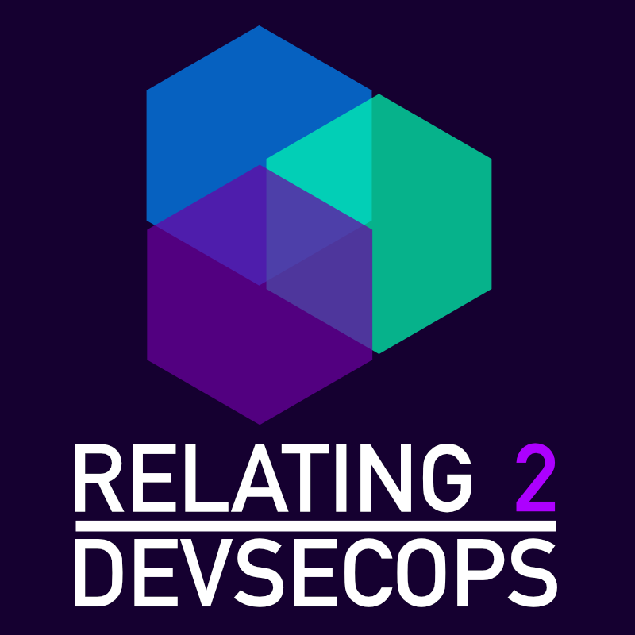

ThanK you!
mike@cloudsecuritypartners.com
CloudSecurityPartners.com
@mccabe615

